Slide 1
Remote healthcare
By Ankita maity

Slide 2
CONTENTS
Introduction
History
Existing state of remote heathcare
Categories of remote heathcare
Enabling technologies
Next-generation devices
Advanced and experimental services
Benefits beyond outcomes
Uses and limitations
Research for the future and challenges

Slide 3
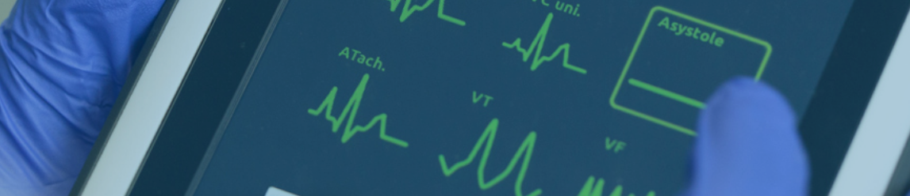
INTRODUCTION
What is remote heathcare?
Why do we need remote heathcare?

Slide 4
For generations, medical care around the world has looked more or less the same. Every year, we all make an appointment and visit our doctor. Beyond that, when something goes wrong and we aren’t feeling well, we make another appointment and go back to the office for another visit.
For people who live in rural areas, people whom travel to a medical facility is difficult, or people who may be too busy to make time to go to a medical centre, remote healthcare provides a solution.

Slide 5
Remote healthcare is a form of telemedicine service, which allows constant monitoring of a patient’s condition and the performance of preventive and control check-ups outside the hospital environment. This form of care is made possible by the use of portable medical devices recording specific vital signs. Test results are automatically transmitted to the Remote Healthcare Centre, where they are analysed. If any irregularities are found, medical staff connect the patient remotely with their doctor or a specialist, and in the event of a health emergency or life risk, call an ambulance. Remote healthcare services support diagnostics, complement therapies and impact the effectiveness of treatment and the patient’s feeling of safety by ensuring permanent contact with specialists. They are complementary to the provision of primary care, have proven medical value, and support patient-doctor communication, especially during the medical interview.

Slide 6
Since it can save travel time and expense for providers and patients, remote healthcare can improve the chances that people will receive preventive care and better management of chronic conditions.
Remote healthcare can facilitate specialist consultations, whether the provider is across the state or across the world.

Slide 7
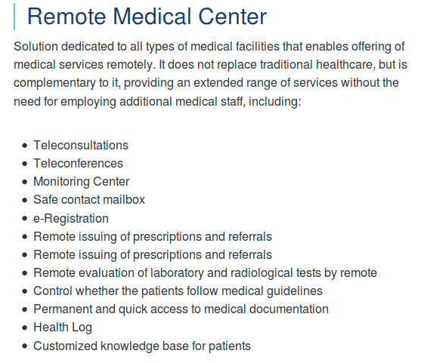

Slide 8
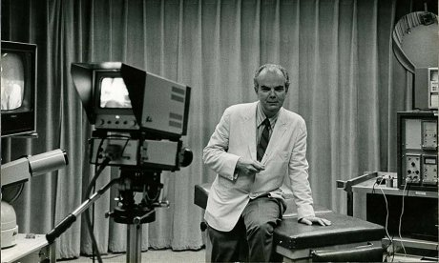
HISTORY OF REMOTE HEATHCARE
When was remote heathcare first used and why?
What were the developments throughout the world?
Kenneth Bird

Slide 9
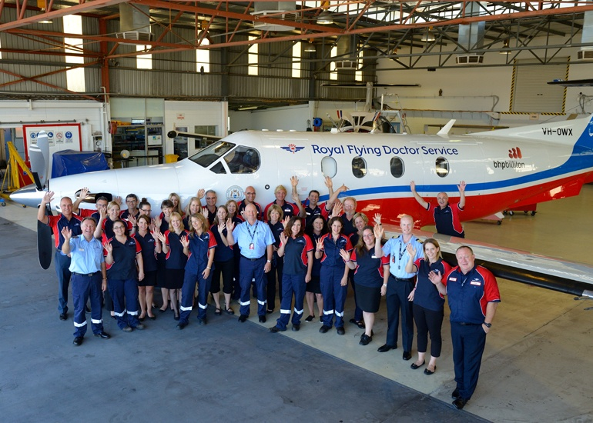
In the early 1900s, people living in remote areas of Australia used two-way radios, powered by a dynamo driven by a set of bicycle pedals, to communicate with the Royal Flying Doctor Service of Australia.

Slide 10
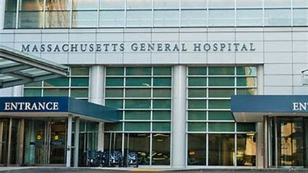
In 1967 one of the first remote healthcare clinics was founded by Kenneth Bird at Massachusetts General Hospital.
The clinic addressed the fundamental problem of delivering occupational and emergency health services to employees and travellers at Boston's Logan International Airport, located three congested miles from the hospital. Over 1,000 patients are documented as having received remote treatment from doctors at MGH using the clinic's two-way audio-visual microwave circuit.

Slide 11
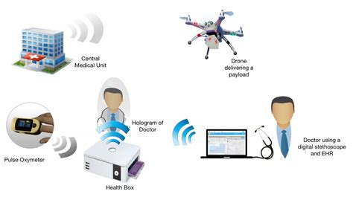
EXISTING STATE OF THE ART
How is remote heathcare practised today?
Existing practices

Slide 12
Having “e-visits” or face-to-face doctor’s appointments using FaceTime, Skype or other audio-visual methods.
A provider sending test results to a specialist and later consulting by phone/email.
A doctor treating a child in a small regional clinic consulting with a paediatric specialist at a large hospital using live video so the specialist can see the patient.
Providers take continuing education courses online.
Patients logging into a patient portal for test results.
Doctors getting access to patients’ medical records via their smartphone.

Slide 13
Categories OF REMOTE HEATHCARE
Remote healthcare can be broken into three main categories: store-and-forward, remote patient monitoring and real-time interactive services.

Slide 14
Store-and-forward
Store-and-forward healthcare involves acquiring medical data (like medical images, bio signals etc.) and then transmitting this data to a doctor or medical specialist at a convenient time for assessment offline. It does not require the presence of both parties at the same time. Dermatology, radiology, and pathology are common specialties that are conducive to asynchronous remote healthcare. A properly structured medical record preferably in electronic form should be a component of this transfer. A key difference between traditional in-person patient meetings and remote healthcare encounters is the omission of an actual physical examination and history. The 'store-and-forward' process requires the clinician to rely on a history report and audio/video information in lieu of a physical examination.

Slide 15
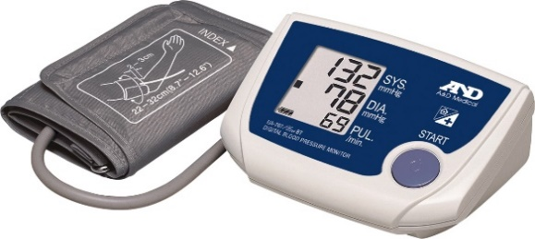
Remote monitoring
Remote monitoring, also known as self-monitoring or testing, enables medical professionals to monitor a patient remotely using various technological devices. This method is primarily used for managing chronic diseases or specific conditions, such as heart disease, diabetes mellitus or asthma. These services can provide comparable health outcomes to traditional in-person patient encounters, supply greater satisfaction to patients, and may be cost-effective. Examples include home-based nocturnal dialysis and improved joint management.
Remote monitoring device for diabetes mellitus

Slide 16
Real-time interactive
Electronic consultations are possible through interactive remote healthcare services which provide real-time interactions between patient and provider. Videoconferencing has been used in a wide range of clinical disciplines and settings for various purposes including management, diagnosis, counselling and monitoring of patients.

Slide 17
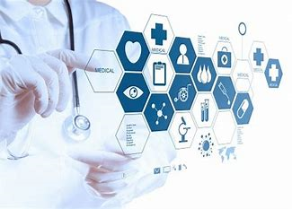
ENABLING TECHNOLOGIES
Enabling technologies include, but are not limited to:
Videotelephony
Health Information Technology

Slide 18
Videotelephony
Videotelephony comprises the technologies for the reception and transmission of audio-video signals by users at different locations, for communication between people in real-time.
At the dawn of the technology, videotelephony also included image phones which would exchange still images between units every few seconds.
Currently videotelephony is particularly useful to the deaf and speech-impaired who can use them with sign language and also with a video relay service, and well as to those with mobility issues or those who are located in distant places and are in need of telemedical or tele-educational services.

Slide 19
Health Information Technology
Health Information Technology (HIT) provides the umbrella framework to describe the comprehensive management of health information across computerized systems and its secure exchange between consumers, providers, government and quality entities, and insurers. Health information technology is in general increasingly viewed as the most promising tool for improving the overall quality, safety and efficiency of the health delivery system.

Slide 20
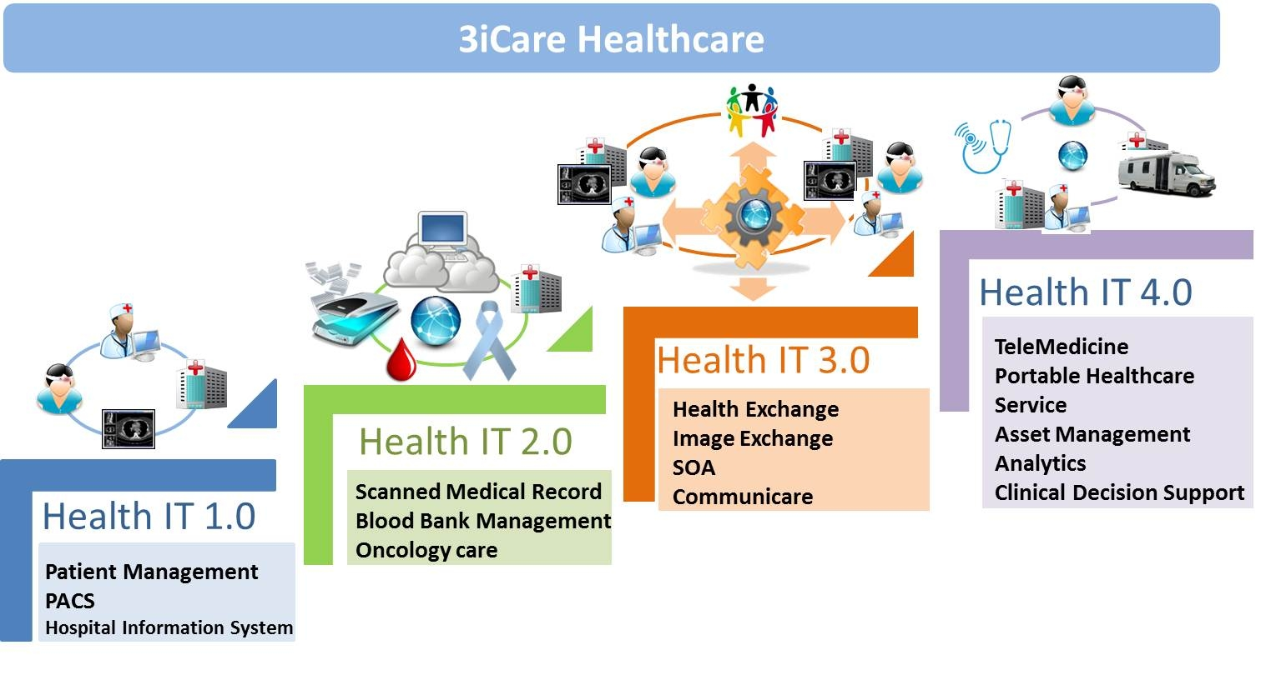
Broad and consistent utilization of HIT will:
Improve health care quality;
Prevent medical errors;
Reduce health care costs;
Increase administrative efficiencies;
Decrease paperwork; and
Expand access to affordable care.
Stages of health IT

Slide 21
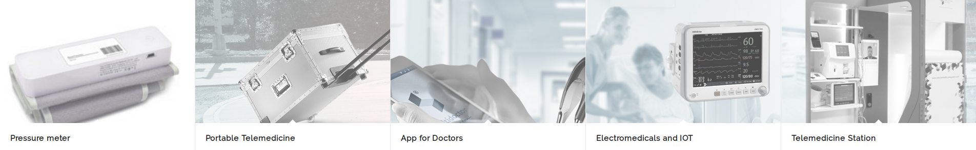
NEXT-GENERATION DEVICES

Slide 22
In India, the health care system is struggling with rising costs and uneven quality so it is important to achieve the best outcome at the lowest cost, with the help of technology. Both the World Health Organization and India's Rural Health Mission consider the use of technology imperative to bringing better health care to India’s most vulnerable people. The challenge is to effectively tap into the $125 billion health care industry. And building a technology driven health care delivery business that makes a difference in the health of the people living in rural areas is the right thing to do.

Slide 23
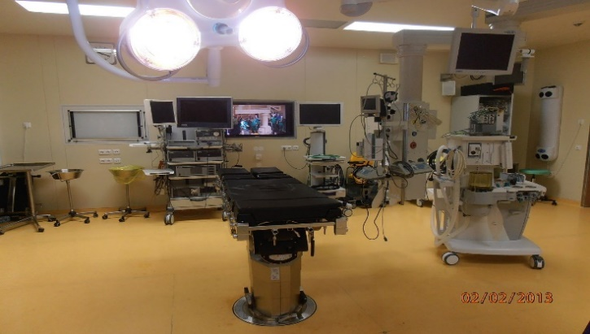
ADVANCED AND EXPERIMENTAL SERVICES
Remote surgery/telesurgery
Robotic teleoperator system chamber

Slide 24
Remote surgery (also known as telesurgery) is the ability for a doctor to perform surgery on a patient even though they are not physically in the same location. It is a form of telepresence. Remote surgery combines elements of robotics, cutting edge communication technology such as high-speed data connections, haptics and elements of management information systems. While the field of robotic surgery is fairly well established, most of these robots are controlled by surgeons at the location of the surgery.

Slide 25
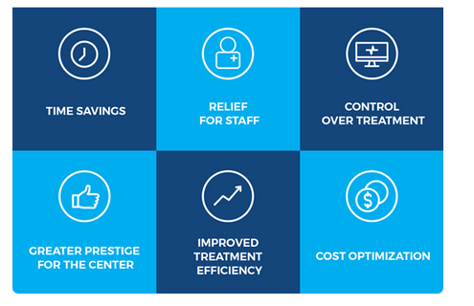
BENEFITS BEYOND OUTCOMES
What are the benefits for patients, doctors, hospitals, insurance companies?

Slide 26
The upside for patients as a result of all this is clear: better care, and better health outcomes, without having to go to the doctor’s office or hospital every day.
For doctors, the real excitement is that these tools allow them to be in two places at once. Keeping an eye on a patient via video, looking at their medical records on their smartphone, studying their X-rays and CT scans from wherever they are, and completing almost any other tasks that are part of their regular work.
On top of that new convenience, a stay in the ICU today costs patients—and their insurers—a lot of money. On average, the fees start at ₹3460 per day and go up from there. The catch for hospitals is that they constantly need to be cycling patients through their facilities in order to free up bed space for others. There is never enough supply to keep up with demand, even at today’s prices.
What remote healthcare does is, now these patients can be monitored—all of their physiological parameters can be measured remotely, including blood pressure, ECG and more—and their physician can have a direct video feed to that patient, along with their medical records.

Slide 27
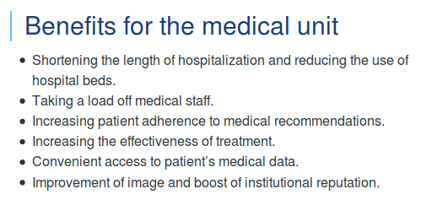
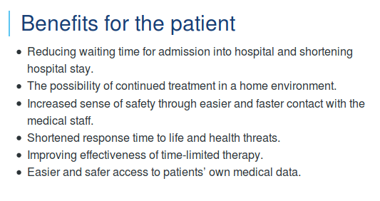
Summary of benefits

Slide 28
USES AND LIMITATIONS
Where can we use this new technology, and where should we not?

Slide 29
Remote healthcare is being used effectively for monitoring patients with hypertension, diabetes, congestive heart failure, wound care and chronic obstructive pulmonary disease (COPD). It is especially well suited to treat conditions such as allergies and asthma, chronic bronchitis, conjunctivitis, urinary tract infections, rashes, prevention and wellness services. Specialists in many fields from dermatology and neurology to ophthalmology and endocrinology practice different forms of remote healthcare. Often, they are located in urban areas and consult with rural facilities through the use of various forms of technology that permit face to face consultation with providers and patients.

Slide 30
Remote healthcare should not be used for the treatment of any condition where a face-to-face exam is required due to severe symptoms (such as bleeding or chest pain) or when immediate and aggressive treatment is needed. In these cases, patients should see their provider or go to an emergency room.

Slide 31
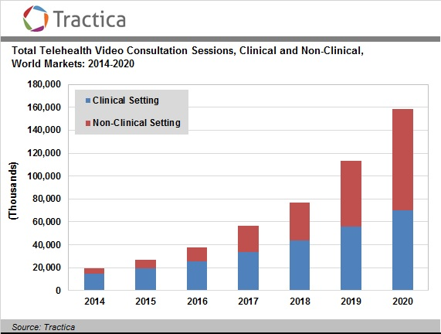
RESEARCH FOR THE FUTURE AND CHALLENGES
What is the current ongoing research in this field?
What are the challenges faced by the researchers while implementing this technology?

Slide 32
Not all practices offer e-visits, yet. With the promise of better access to care without the inconvenience/expense of traveling to an appointment, states and insurance companies are under pressure to define policies governing e-visits and reimbursement.
Practices that do offer e-visits tend to provide them only to established patients for whom follow-up visits do not require a physical exam. There are companies that offer e-visits, usually by phone, for some non-emergency illnesses but these do not allow you to select your practitioner or develop a professional relationship as you would with a primary care provider. Prescription medications may be available during an e-visit, but that decision is at the discretion of the provider and usually won’t include non-therapeutic drugs or controlled substances.
Future work also includes working closely with healthcare service delivery partners and e-governance players to define and implement large scale projects; enhancing the technology with further diagnostics as well as ground-level delivery processes to capture them better; identifying and building relations with partners having complementary solutions (hardware and software); integrating a mobile based Bluetooth enabled telemedicine solution, as even 32 kilobits/s bandwidth is not available in all of rural India; and changing the business model to include software-as-a-service.

Slide 33
REFERENCES
Berman, Matthew; Fenaughty, Andrea (June 2005). "Technology and managed care: patient benefits of telemedicine in a rural health care network". Health Economics. Wiley.
Saylor, Michael (2012). The Mobile Wave: How Mobile Intelligence Will Change Everything. Perseus Books/Vanguard Press
Hjelm, N. M. (1 March 2005). “Benefits and drawbacks of telemedicine” Journal of Telemedicine and Telecare.
Angaran, DM (15 Jul 1999). “Telemedicine and Telepharmacy: Current Status and Future Implications” American Journal of Health-System Pharmacy.
Fatehi, Farhad; Armfield, Nigel R.; Dimitrijevic, Mila; Gray, Leonard C. (October 2014). “Clinical applications of videoconferencing: a scoping review of the literature for the period 2002-2012” Journal of Telemedicine and Telecare.
Hoffman, Jan (25 September 2011). “When Your Therapist Is Only a Click Away” New York Times.
en.wikipedia.org
ieeexplore.ieee.org

